Slide 1

PROJECT GUIDE:
Mr. Amit Patil
Corse name – (22060 )Capstone Project Execution and Report Writing
Program name -Electronics & Telecommunication Engineering
Institution name - Bharati Vidyapeeth’s Jawaharlal Nehru Institute Of Institute of Technology (Polytechnic)

Slide 2


Smart AgroSense: IoT-Based Multi-Point Wireless Sensor System for Precision Farming

Slide 3
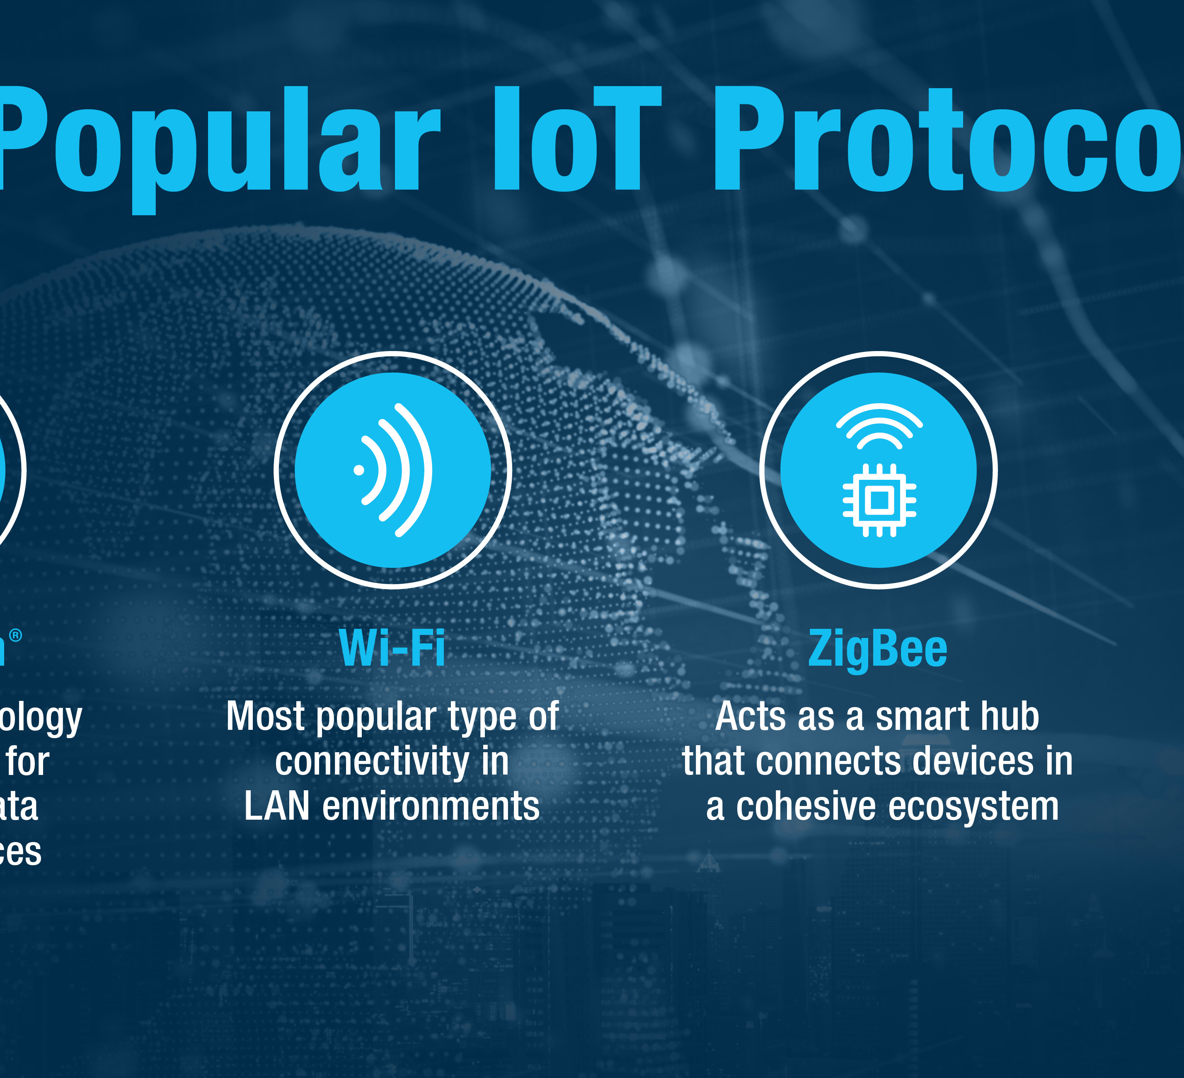
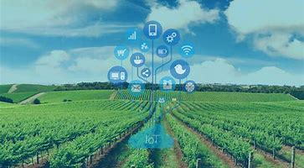
Problem Statement
High complexity in protocol stacks limits rapid deployment and debugging.
Inadequate support for many-to-one data flow in low-power sensor networks.
Existing solutions (e.g., LoRa, Zigbee) are expensive or over-engineered for short-range structured data.
Challenges in maintaining real-time communication with low latency and minimal data loss.
Lack of fallback operation when cloud or internet access is disrupted
Notes:
Problem: Traditional irrigation is inefficient. Need for real-time soil moisture data and automation to conserve water and improve crop health.

Slide 4
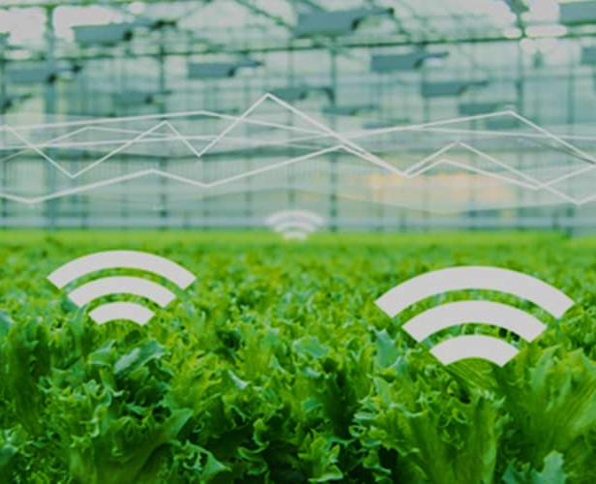
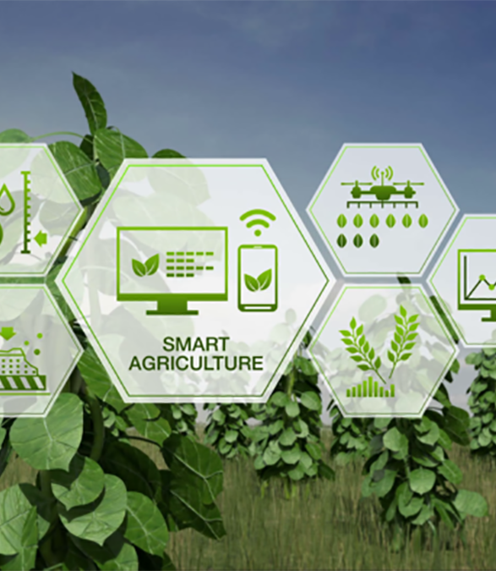
Core Functional Goals:
Wirelessly monitor soil moisture, temperature, and humidity from multiple locations
Display real-time sensor data on the mobile app using an IoT platform (Blynk)
Automatically activate irrigation based on soil moisture thresholds
Send smart notifications to the user when soil moisture falls below the safe limit
Notes:
Objectives: Wireless monitoring, mobile display via Blynk, auto-irrigation logic, push notifications for dry soil events.

Slide 5

Comparative Analysis of Research and Our Contributions
🔍 Identified Gaps in Current Research
• Protocol Complexity – Modern protocols like MQTT-SN require custom stacks that increase overhead [Springer, 2025].
• IoT Security – Many IoT devices lack secure configurations or insight into their software layers [Nozomi Networks, 2024].
• Energy Efficiency – Energy use during wireless data transmission remains high [MDPI Electronics, 2024].
• Real-Time Data Handling – Scaling systems while maintaining responsiveness is still a challenge [Springer, 2025].
✅ Our Project’s Contributions
• Lightweight, Struct-Based Protocol using NRF24L01 for minimal overhead and fast transmission.
• Communication-focused architecture with offline fallback handling and modular expansion.
• Secure and energy-efficient communication tailored for microcontroller constraints.
• Real-time, many-to-one data handling across three active sensor nodes.

Slide 6
Why We Chose NRF24L01 Over LoRa, Zigbee, and Wi-Fi
Protocol | ~Range | Power Usage | Cost/Node | Data Rate | Integration Ease | Suitability
NRF24L01 | ~700 m (w/ PA+LNA) | Low | ₹150–₹200 | Up to 2 Mbps | Easy ( ESP32) | ✅ Ideal
Zigbee | ~10–50 m | Medium | ₹400–₹600 | 250 kbps | Moderate | Possible
LoRa | 1–5 km+ | Very Low | ₹700–₹1200 | < 50 kbps | Complex (custom stack) | Unnecessarily complex
Wi-Fi | 30–50 m | High | ₹400+ | High (~10 Mbps) | ✅ Built-in (ESP32) | For cloud only

Slide 7


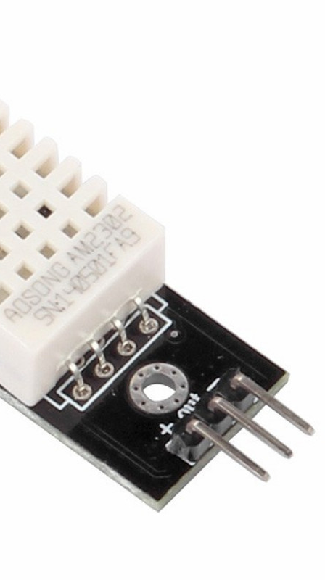
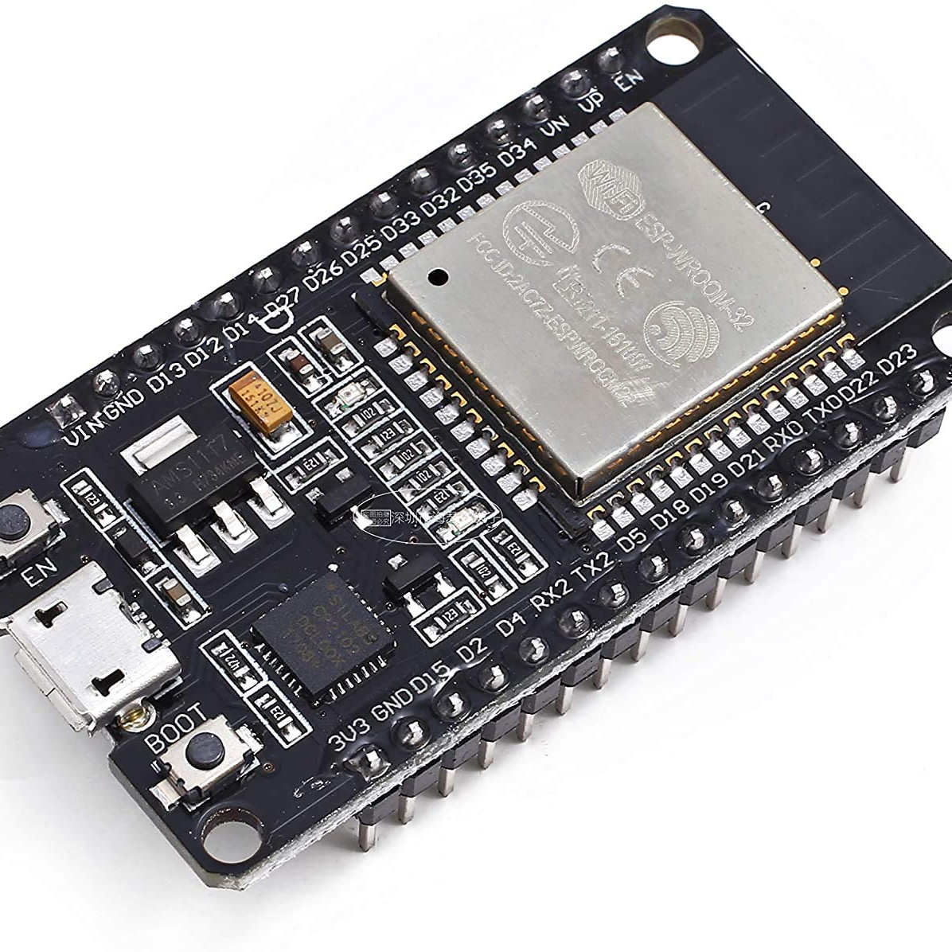
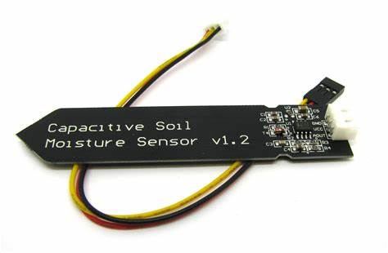
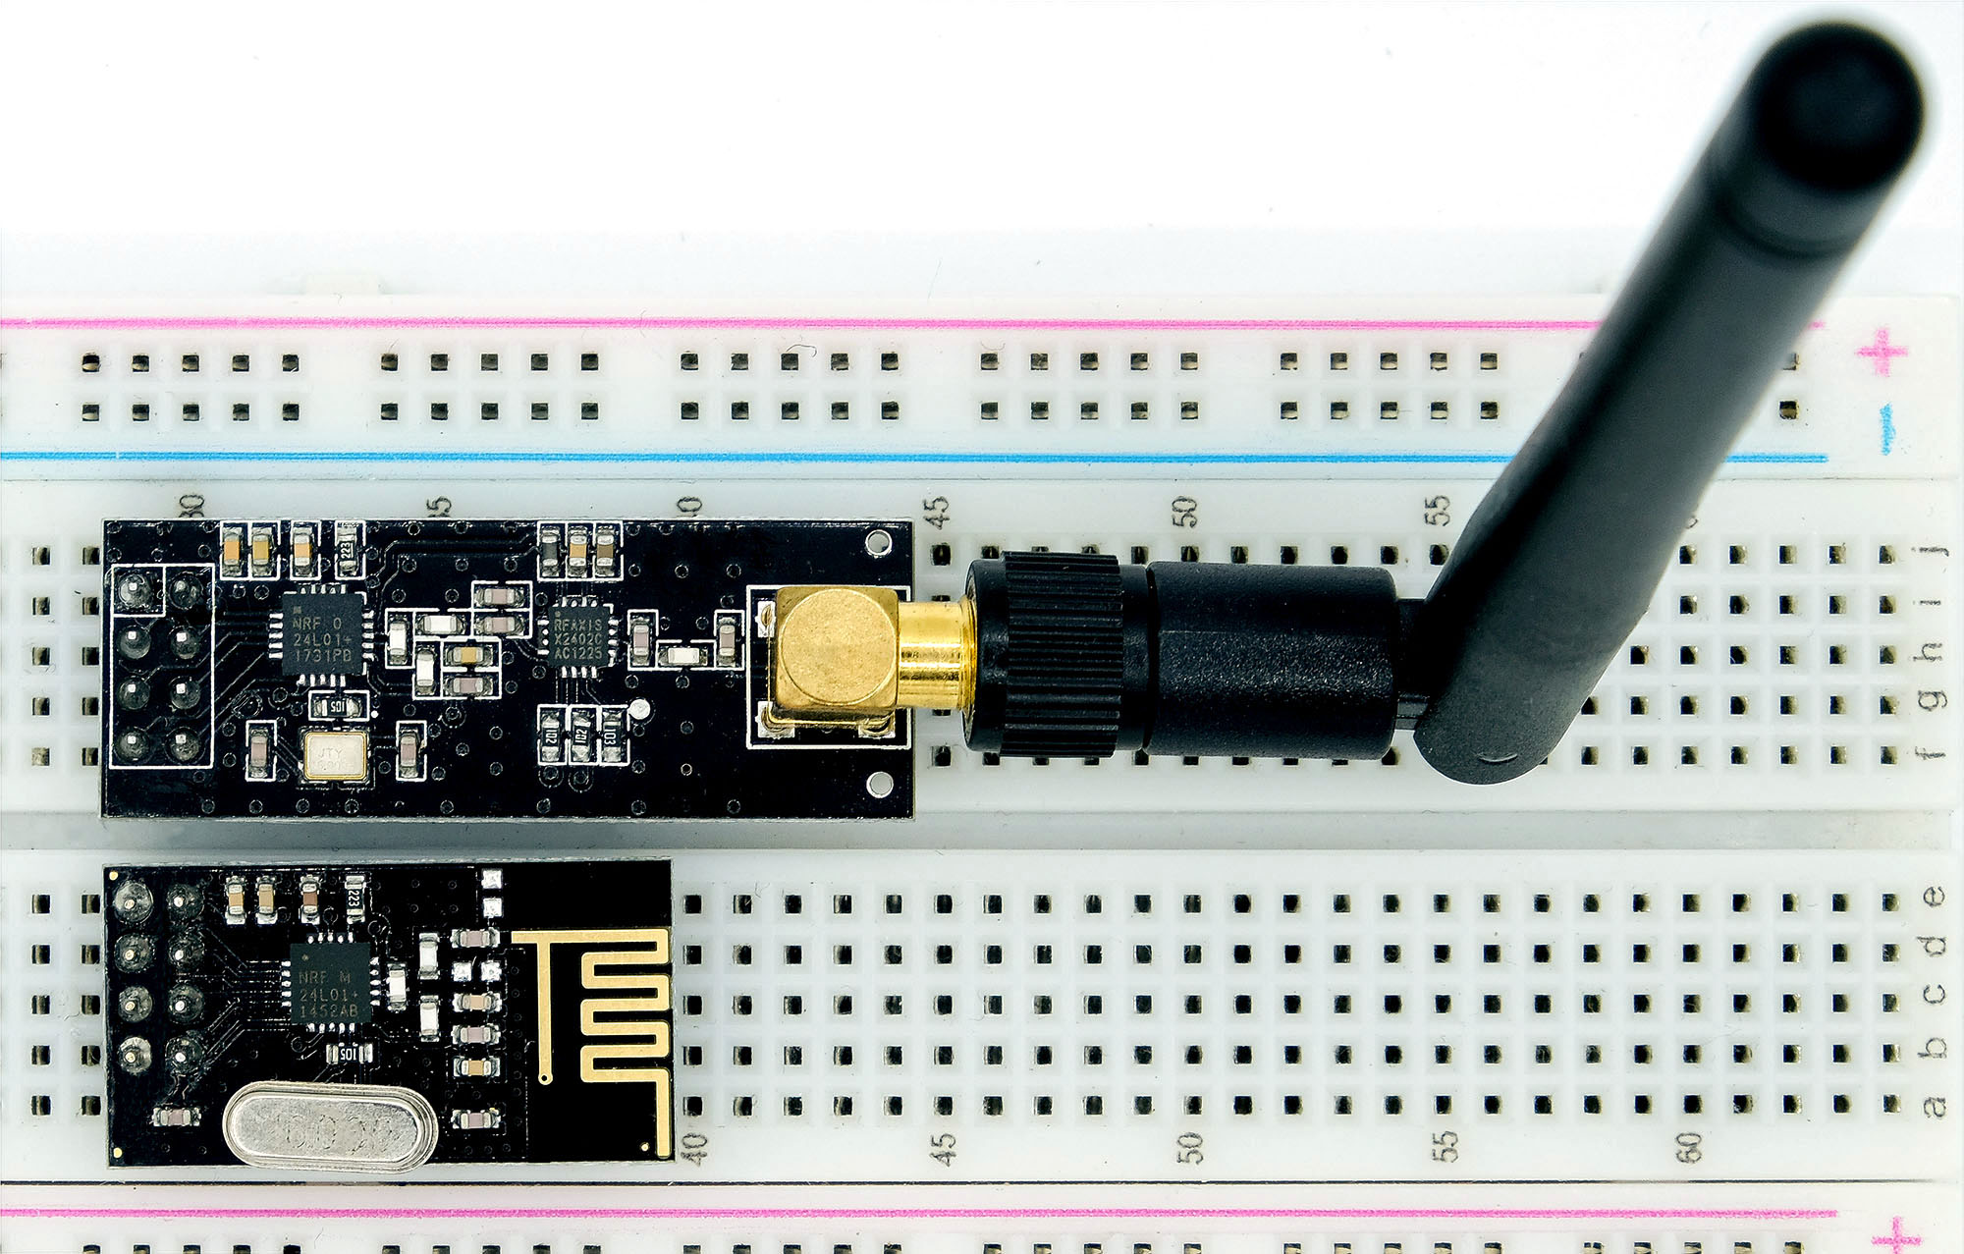
Hardware Components
ESP32 – Main controller and Wi-Fi module
NRF24L01 – Wireless transceiver for nodes
DHT22 – Temperature and Humidity sensor
Soil Moisture Sensor – Analog soil sensor
Relay Module – Controls water pump
DC Pump – Waters the plants automatically
Notes:
Hardware: Describe components and rationale for their selection (cost, availability, performance).

Slide 8
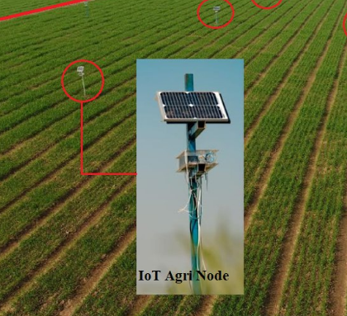
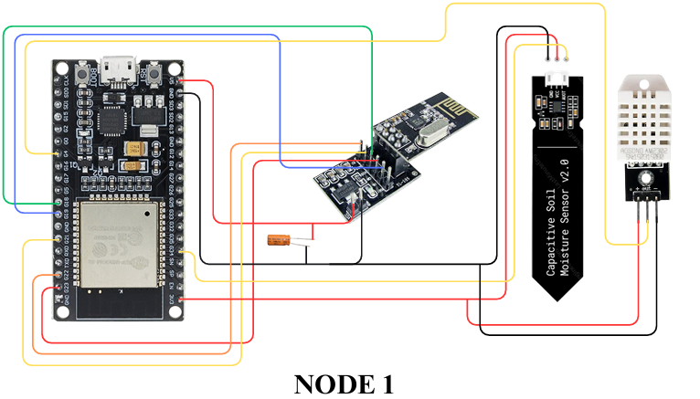
Node Architecture
Each node includes DHT22 + Soil Sensor + NRF24L01
Sends structured sensor data wirelessly
Unique Node IDs for identification (N1, N2, N3) ===================================================
Data Handling Workflow per Node:
Sensor Sampling -ESP32 reads DHT22 and soil moisture data every few seconds.
Struct Packaging Data is placed into a struct with fields: Node ID, Temperature, Humidity, Soil Moisture, Relay State.
Relay Decision Logic :If soil is too dry, relay GPIO pin is activated to turn ON the pump.
Wireless Transmission via NRF24L01 ESP32 sends the struct to a central ESP32 receiver using a unique address like "NODE1".
Notes:
Node Architecture: Detail the sensor wiring, code flow: read DHT22, soil sensor, package as struct, send via NRF24.

Slide 9
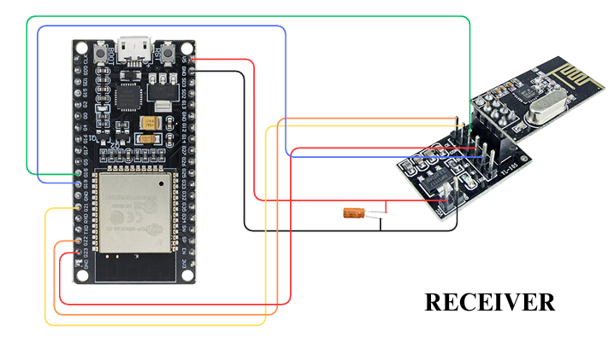
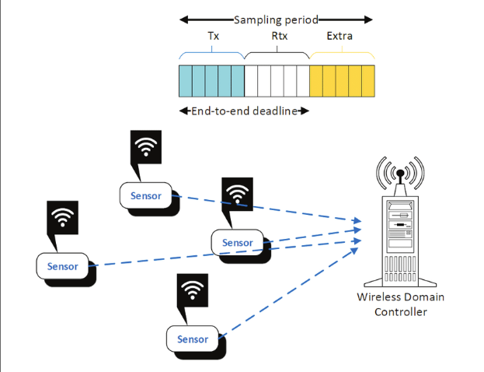
Receiver (ESP32)
Receives data from multiple nodes using NRF24L01
Parses and forwards sensor values to Blynk cloud
Sends notification alerts based on soil threshold
Notes:
Receiver: Explain NRF24 configuration, pipe setup, parsing struct, Blynk integration for cloud upload.

Slide 10
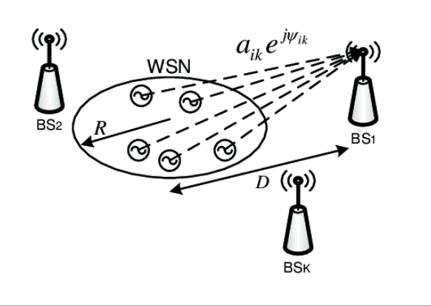
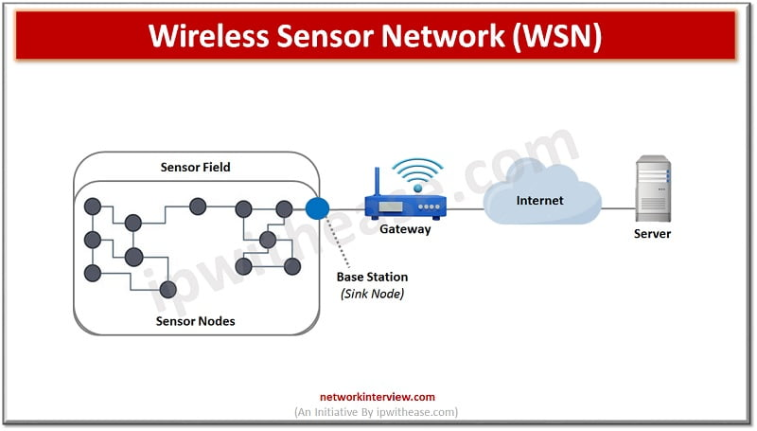
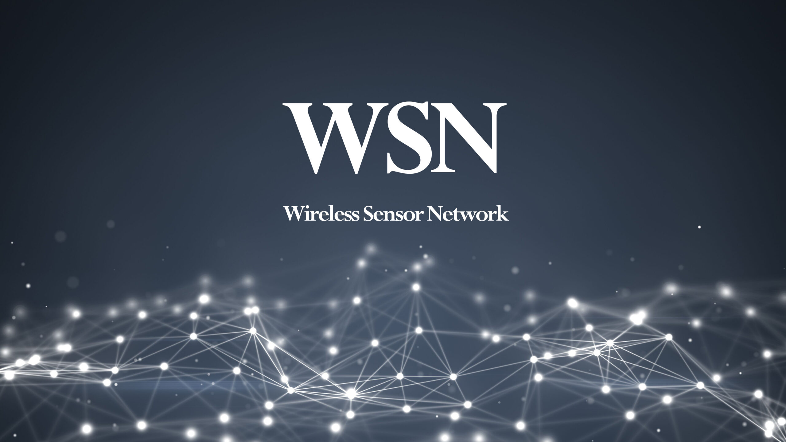
System Overview
Sensor Nodes (N1, N2, N3) with DHT22 + Soil Sensors
NRF24L01 transmits data to ESP32 Receiver
ESP32 sends data to Blynk Cloud
Mobile app displays real-time data and alerts

Slide 11
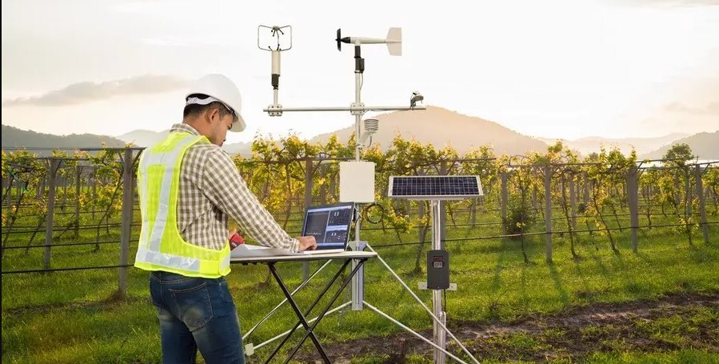

Key Competitive Features:
Many-to-One Wireless Architecture – Seamless data transmission from multiple sensor nodes to a single ESP32 receiver
Offline Auto-Control with Plan B Integration – Node 3 autonomously controls the water pump even if Wi-Fi or receiver fails
Compact & Structured Data Transmission – Efficient, low-latency communication using lightweight struct packets
Hybrid Cloud + Local Monitoring – Real-time cloud sync with Blynk + Serial fallback for network downtime
Smart Alerting System – Intelligent flag-based alerts that notify only when conditions change, avoiding spam

Slide 12

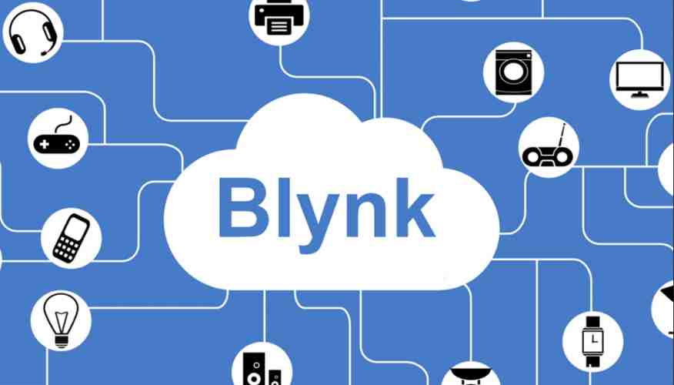
Blynk Cloud Integration
ESP32 uses Wi-Fi to send sensor data to Blynk
Blynk dashboard displays temperature, humidity, and soil moisture
Push notifications sent when soil is dry
Notes:
Blynk Integration: Show how virtual pins map to sensor variables, dashboard setup, and notification events.

Slide 13
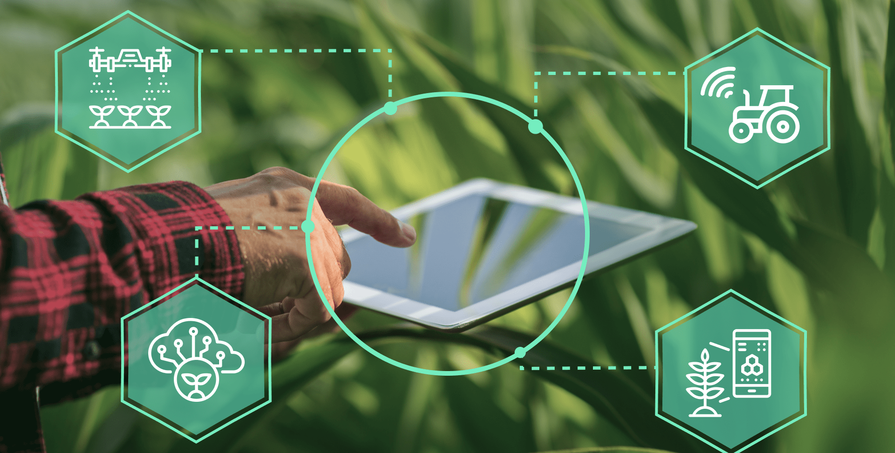
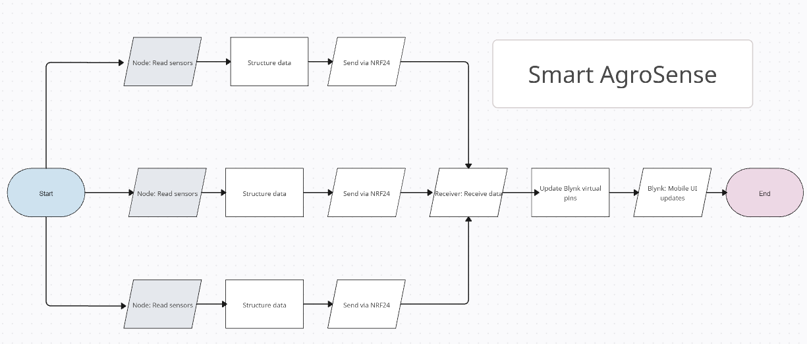
Software Workflow
Node: Read sensors → Structure data → Send via NRF24
Receiver: Receive data → Update Blynk virtual pins
Blynk: Mobile UI updates → Trigger alerts if needed
Notes:
Software Flow: Step-by-step code execution on nodes and receiver, error handling, retransmissions.

Slide 14

Future Scope
NRF-based long-range nodes
Solar-powered nodes and pumps
Mobile app threshold customization
SD card data logging with real-time clock
Increasing number of nodes
Notes:
Future Scope: Propose enhancements: solar power, LoRa, threshold configuration via app, detailed data analytics.

Slide 15

Conclusion
Smart AgroSense enables remote farm monitoring
Provides reliable soil health alerts
Combines wireless sensors, cloud, and automation
Flexible fallback modes ensure robustness
Notes:
Conclusion: Summarize achievements: robust wireless monitoring, automation, notifications, Plan B, demonstration readiness.

